Slide 1
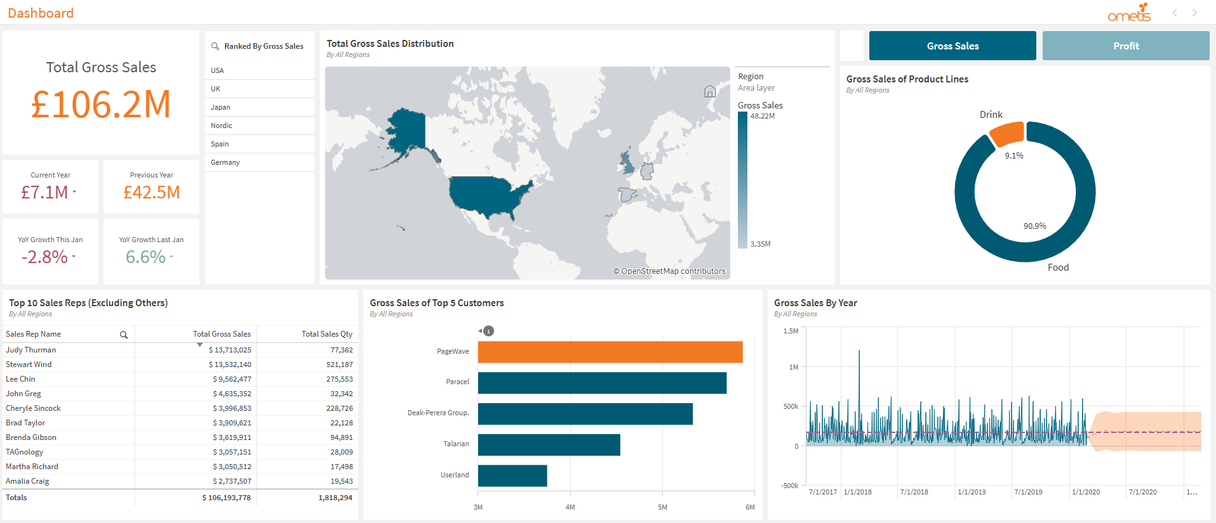
Q1) Which Region had the highest (Gross) sales?
There are 6 key regions with recorded data for gross sales. The region with the highest sum of (gross) sales is the USA, followed by UK, and Japan. The left side contains a list box of regions ranked by sales, whilst the map contains a heat map showing the rough distribution (for comparison) of total gross sales globally. The specific amount can be found by clicking said region and it will be displayed on the KPI for 'Total Gross Sales', or hovering on the map.

Slide 2
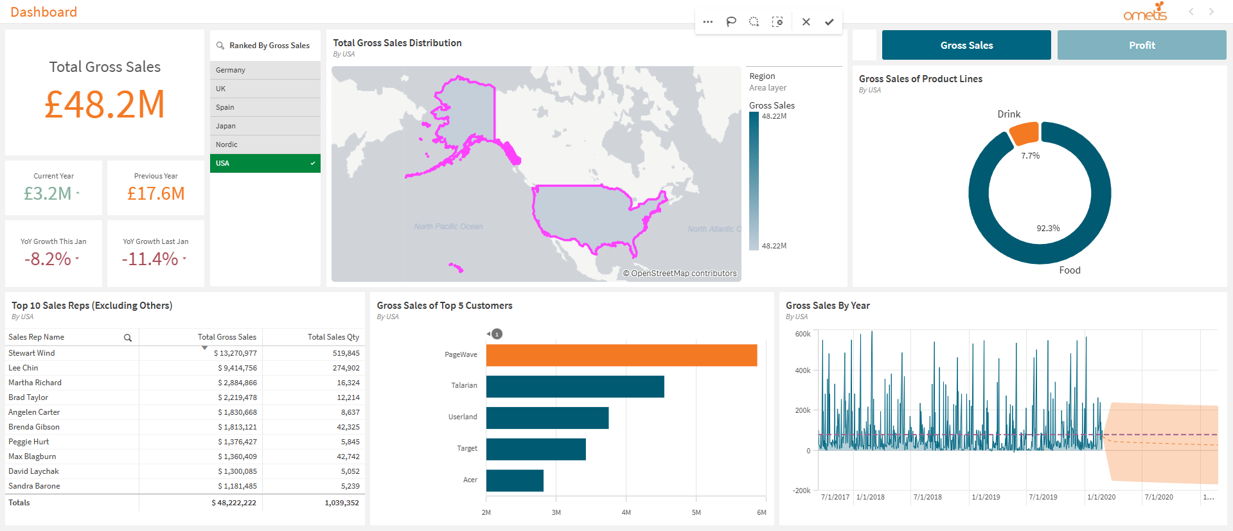
Q2) Which was the best-selling product line in that region?
Only 2 product lines exist for each region, 'Food' and 'Drink'. Food is the best-selling product line in the USA, having around 9 times more the amount of sales. This is roughly the same for all regions, not just the USA, excluding Japan which is around 5 times. The product line sales is displayed on the donut chart. By default, sales of product lines are displayed for all regions, however region selections can be made via list box or map.

Slide 3
Q3) Who are the top 10 sales reps globally?
The table shows that Judy Thurman has the best performance in terms of gross sales with around £13.7M, followed shortly by Stewart Wind. However, in terms of sales quantity, Stewart Wind a better performance. By default the table displays the top 10 sales reps of all regions, however filters can be applied whether for region, product line, something else, or a mix.
Note: 'Others' was excluded due to it being too vague in terms of who the sales rep is. It could be multiple people for all we know.

Slide 4
Q4) Who was the biggest customer globally?
PageWave has the highest sum of gross sales, and therefore the biggest customer of all regions, and they are shortly followed by Paracel. The bar chart displays top 5 customers, with the biggest customer being highlighted (this also works with filters).

Slide 5
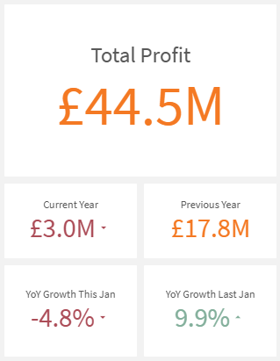
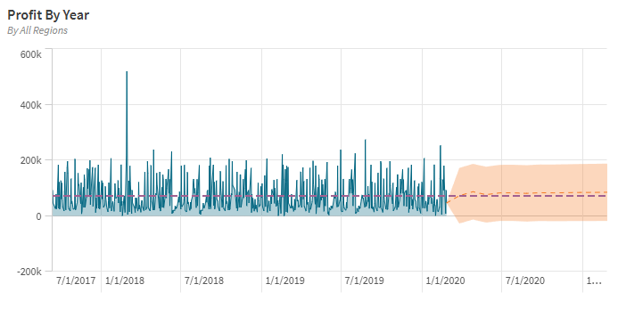
Does this dashboard follow the guidelines?
Executive Style Dashboard
A single sheet dashboard designed to be easy to understand and quick to read. KPIs are highlighted for progress tracking of key goals that can be referenced for executive level decision making. The data set provided suggests a commercial business, therefore the main focal points will be profit related. As previous dates are provided for sales , the best comparators will be sales/profit of previous months/year to the current year to indicate growth or regression.
Forecasts, trendlines, and reference lines for goal and performance tracking.
Branding
Analytics challenge stated the employer was not Digital Native, and that branding should be taken into account in the design. The employer is Ometis, who is partnered with Qlik. With this taken into account the logo of Ometis was used in the top right of the dashboard as branding, along with a rough colour scheme of orange and dark turquoise that is commonly used on their website.
Requirements
A list of activities were included in the PDF which serve as a minimal list of requirements for 'things that the employer expects to be included'.
The slides above and below show evidence of these activities being completed.

Slide 6
SC1) Can you project next year's sales?
The line graph displays the fluctuations of gross sales by recorded dates. The provided data displays gross sales up to the year 2020, with (the next 12 months) 2021 being forecasted to being around £185K on average in terms of sales. At a 0.9 confidence level, this average range can vary between approximately -£50K to £450K.
Note: The sample data was only up to the year 2020, so I based the context of 'next year' around the data available (2021), instead of 2025.

Slide 7
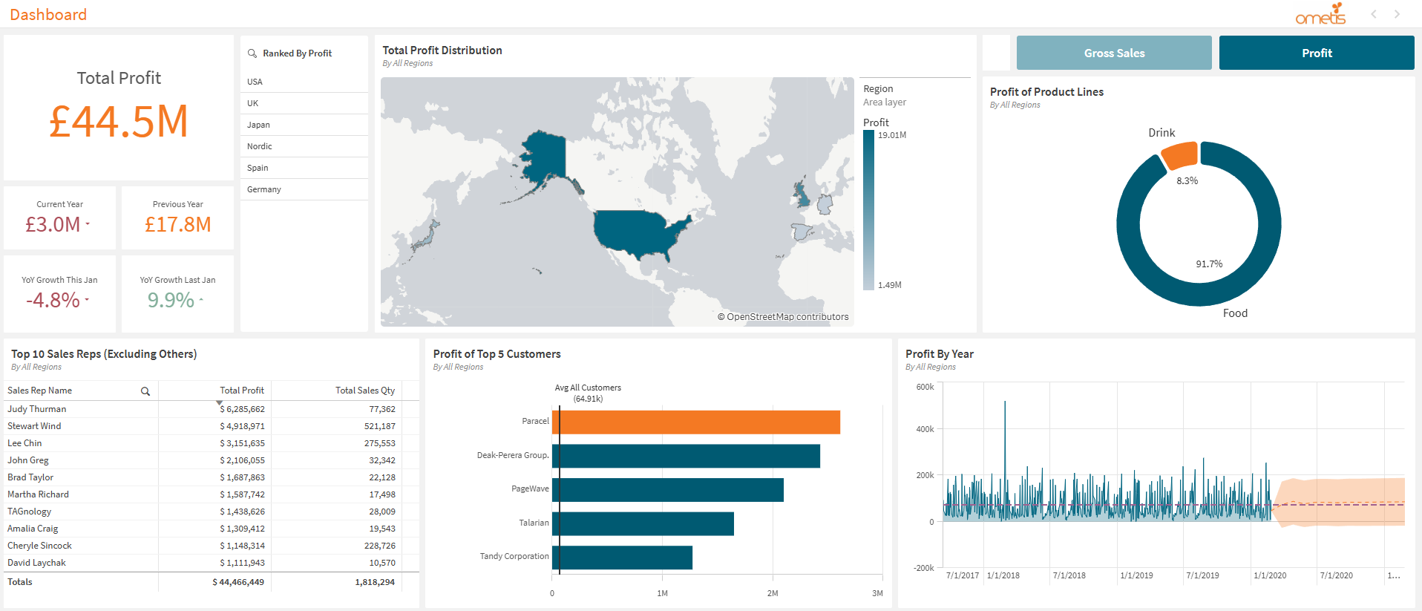
SC2) Can you answer the previous questions but for profit?
I've added toggleable buttons that can switch the state of the dashboard between 'Gross Sales', and 'Profit' (Gross Sales – Cost).
When profit is toggled on, the gross sales button is greyed out to indicate a switch in state, and all relevant visuals on the dashboard will be changed accordingly to the new master measure that is 'mProfit'.
Note: This is all done on the same sheet, so it still qualifies as an executive style dashboard.

Slide 8
SC2.1) Which Region had the highest profit?
As with gross sales, USA occupies the top position for the most profit made (with £19M) between all regions. The other regions also retain their same positions. The only difference being a smaller number due to deductions from costs.

Slide 9
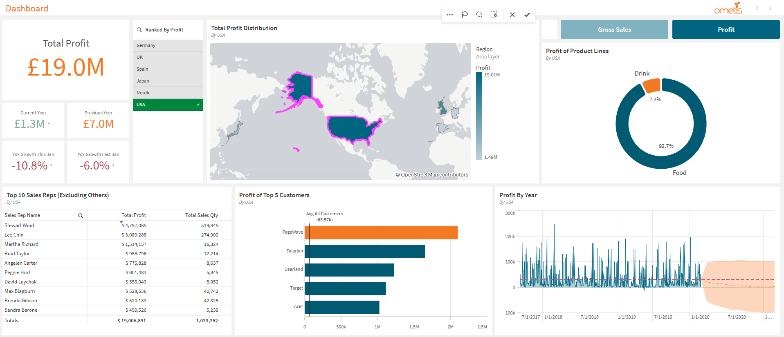
SC2.2) Which was the best-selling (profit) product line in that region?
'Food' is the most profitable product line in the USA. The percentages are roughly the same for profit and gross sales (with no change in quantity), indicating the overall profit margins should be around the same between the two product lines.

Slide 10
SC2.3) Who are the top 10 sales reps for profit globally?
Judy Thurman is also the sales rep who generates the most profit followed by Stewart Wind.
The top 4 positions for total profit made by sales reps remain the same, however the subsequent 6 seems to change when compared with gross sales.

Slide 11
SC2.4) Who was the biggest customer for profit globally?
The most profitable customer is Paracel rather than PageWave, suggesting that the overall costs for PageWave is very high. There could be a number of reasons for this such as transportation costs, or PageWave buying in bulk.
Further analysis is needed for the context behind this.

Slide 12
SC2.5) Can you project next year's profit?
The forecast for profit is roughly the same as with gross sales except smaller numbers.

Slide 13
Reflection
Impressions
The process of developing the dashboard had its ups and downs. As someone who has never used Qlik prior to this challenge, my initial impressions on the software was a toned down version of Power BI, and to some extent it is, visuals are easier to construct, the UI (for the most part) is easier to understand, and it feels very rewarding to use. However, as I delved deeper I realised the software has a lot more depth to it than I thought, whether it's creating expressions for conditional formatting, using CSS, or the extensions I haven't even explored yet. I admittedly spent more time experimenting with the various features than creating the dashboard.
As for the design; although I've created a dashboard I'm satisfied with, it felt deceptively more challenging than it should have been. Often times or not, the visuals I create give me the impression that they're better off in an operational rather than an executive style dashboard, this is probably because of the overlap in terms of design. As a result I ended up iterating over the dashboard on several occasions to ensure that it meets the criteria of being an executive style dashboard.
Despite all this, I found the challenge very rewarding after seeing a complete and functional dashboard that meets the expected requirements. My expectations of a data analyst still remain the same, and I would like to explore further if possible, such as data architecture which was not explicitly used for this challenge.
Challenges
Asides from the design that I've mentioned in my impressions. The other challenge I've encountered was a lack of experience in operating Qlik, which often limited what I could create. Although I have some experience with Power BI and programming, some expressions took a lot longer to create than necessary due to a gap in knowledge.
What can I do to improve next time?
Spending more time learning Qlik would be the most obvious answer. Although I went through the tutorials, this only covered the surface level knowledge. The problem becomes abundantly clear for more complex measures, which could have been simplified or resolved more elegantly if I had a better understanding of variables and master measures (see KPI card expressions). If I want to develop a more complex dashboard, further reading is mandatory..

Slide 14
Development Process
Tackling the Problem
I'm not familiar with the development process of data analytics, I so I adapted the software development lifecycle into steps (that seemed applicable) which I would need to take in developing the dashboard, based on my personal experiences with Power BI.
Since the data set was already cleaned, this already eliminated a step I needed to take, and I could focus entirely on the design of the dashboard.
There's a lot to cover, so the Steps Taken can be treated as a TL:DR.
Steps Taken:
Breaking Down the Problem Statement.
Identifying the aims and objectives.
Drafting a list of basic requirements.
Planning.
Learning how to operate Qlik via provided tutorials.
Research case studies of executive style dashboards.
Determining what types of graphs should be used according to requirements.
Consider the viability of the plan and any risks involved.
Implementation.
Create base visuals that cover the basic requirements and plan.
Arranging the visuals in a way that can convey a story whilst adhering to basic UI principles.
Polish.
Edit the sheet according to the specified branding – e.g. Colour, visualisations, etc.
Edit visuals where appropriate whilst adhering to design principles – e.g. White space, consistency, conditional formatting.
Any additional adjustments that can improve user experience.
Test/Debugging.
Test the dashboard for a wide range of use case scenarios.
Ask someone to test the dashboard.
Fix any issues that were encountered during testing.

Slide 15
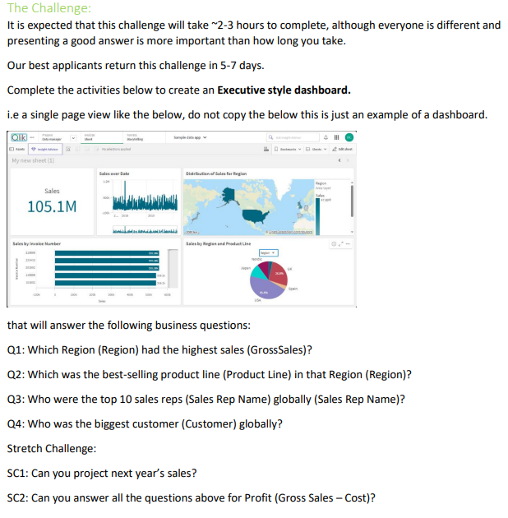
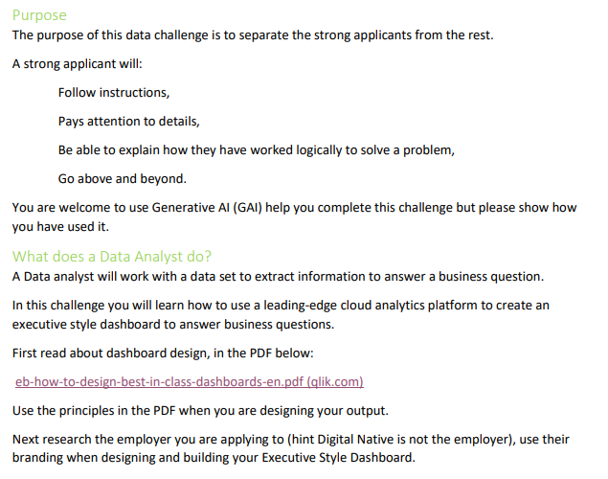
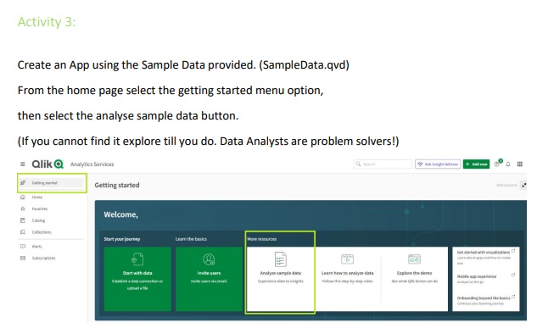
Breaking Down the Problem Statement
The problem statement can be interpreted as the PDF provided that provides instructions on what needs to be done.
I spent some time identifying and highlighting the key points that I would need to take note of when planning.
Data set.
Type of dashboard.
Didn't use any. But good to know.
Qlik.
Employer is Ometis.
Activities/requirements.

Slide 16
Planning
Learning Qlik & Research
Not much to talk about here. Spent an hour or so going through Qlik tutorials that were linked on the PDF, and read through the dashboard design article. Research was predominantly looking through google images of various executive style dashboards to get a feel for their design, as well as a few online articles on any key principles to be kept in mind.
A few things to note:
End-user is likely a CEO or executive-level management.
KPIs needed for decision making.
Performance tracking for business aims/goals.
Visuals should be concise and straight to the point.
Adaptable to live data and large growing data sets.
Graphs/Charts for Key Visuals
We know what the main visuals need to be, as they're listed on the activities, so the main focus will be what visuals should be adapted for which activity.
Things to note:
Graphs/charts are preferred over numeric metrics where possible as this improves readability for comparisons, and takes less time to comprehend.
Analytical charts (e.g. box/distribution plots) will be ignored since they may not be suitable for the end-user due to time and knowledge needed to understand them.
Examples:
Q1) Bar chart or a heat map.
We're comparing regional data, and these two are the most suitable of this data type.
Heat map was chosen in consideration of more region values being added in the future. We shouldn't have to scroll through data to read it.
For easier value comparison, a ranked (sorted) list box was also added to the side.
Q2) Pie/Donut chart.
Only two product lines. Therefore these visuals are the easiest to understand.
Donut was used so data labels are more readable.
Q3) (Pivot) Table or bar chart.
Ranked values – These are the 'easiest to understand and compare' visuals of this data type.
Bar chart consumes too much real estate due to 10 columns/rows, pivot table forces totals at the top which is unintuitive, therefore a normal table is used.
Q4) Bar chart – 'A variety of graphs/charts' was specified somewhere in the PDF, so this was chosen.

Slide 17
Implementation
Creating Visuals
Once again not much to talk about here, the main bulk of the development was polishing the design. Creating the visuals themselves didn't take too much time due to the drag and drop nature of fields and visuals, the rest is just spacing out the visuals and story boarding.
Storyboarding
Ometis is a UK based business, therefore English is the main language, this means we read from: left to right, top to bottom, in the pattern of a 'Z'. Therefore in most cases, the most important visuals will be on the top left, and the least being at the bottom right of the sheet.
Size and logical grouping are also important to consider as this improves readability - although this seems like a small thing, it can greatly improve user experience due to the time saving nature of comprehensibility. The bigger something is, the more we notice it, therefore the more important the visual the larger it should be. Related visuals should also be grouped up, this makes it easier to understand and reference back to – e.g related metrics and text fields should be clustered together, and charts and graphs together.
With all this in mind I placed KPI cards at the top left, KPIs are the most defining elements of an executive style dashboard, however they need other visuals to provide context hence why I've left them with a size smaller, this is also supported by the fact that charts and graphs take up more space to be readable than text. Moving onwards is the region heat map, this dashboard is for a commercial business, therefore profit is the most defining factor for success. The more territories a business occupies; the larger the room for potential profit, therefore this is the second most important (and largest) visual, it's also placed at the centre where our eyes are naturally placed. The visuals for Q2-4 have roughly the same importance, the table was placed at the lower left so it's aligned with the other text based fields, whilst the product lines on the top right, as Q2 was linked to the region map, therefore making it the most logical position for reading, assuming that the end-user looks at the product line performance for each region.
The line chart was later added for the challenge activities. It was made larger than Q2-Q4 due to it having forecasts and trendlines which are a form of KPI. As for why it's at the bottom right despite its higher importance? It aligns better than when placed at the bar chart position, creating less visual noise.

Slide 18
Polish Pt 1: Improving the Current Dashboard
Branding
With the template of the dashboard complete it's time to move onto improving how the dashboard looks.
The easiest thing to start with is colour. As this dashboard was designed for the employer (Ometis) we can derive a colour palette from their existing branding, these would be the bright orange and darker turquoise commonly seen on their website. White will be used as the base coat background as it allows for the most contrast between colours, which improves visibility when paired with black/monochromatic font.
Key elements would then be highlighted in either orange or turquoise to indicate key information, these would be KPI values, top customers, the heat map, or contrast for the donut chart. To finalise the branding, I added the Ometis logo to the top right of the dashboard.
Improving User Experience
There are several methods to go about this but the simplest is consistency. I went through all the visuals and ensured that the font-size, colour, and background borders all had the same formatting. From there I moved onto metric consistency – numerical data will all have the same decimal places where applicable, currency will use '£' since Ometis is UK based, and data labels use the same formatting. That being said, I had some issues with expressions so I wasn't able do this for every piece of data and visual (e.g. Heat map legend).
Removing redundant data improves readability. If the title states what the visual is, then it's unlikely you will need axis titles, (some) legends, or data labels if the axis is readable. Ensure that all visuals have an appropriate amount of data to extract information from, too little leaves the question of why you have the visual in the first place, therefore enable data labels if needed (donut chart), whereas some visuals are better off having them turned off due to an overabundance of data (line graph). Another way to improve readability are axis ranges. By exaggerating axis ranges, it becomes much easier to compare values on the same graph. This was applied for the min value (of the bar chart) using an expression that takes the minimum value of the top 5 customers, and rounding down (floor) to the nearest million.
White spacing can also help, and it limits information bloat. Fortunately, by default visuals have spacing due to their 'snap to grid' characteristics. For visuals which seem compact, padding can be added using CSS. This was applied to the heat map on the left and right (CSS style on the KPI card next to the buttons).

Slide 19
Polish Pt 2: Stretch
KPIs
The first line of action would be to add the final visual, the 'gross sales by year'; which is suitable for a line graph due to it having fluctuating data. Asides from the forecast of next year's gross sales, I also added an average trendline which will help indicate whether performance of gross sales is doing better or worse than normal. In the same vein, a reference line was added to the top 5 customers showing the average gross sales amongst customers.
Originally the 4 KPI cards underneath 'Total Gross Sales' KPI card was for sales quantity. This was later changed to its current state for better KPI tracking. These visuals would indicate the overall financial performance by comparing the gross sales of the current year to the previous fiscal year. Year over year growth would compare months of the last year to the current year to determine periods of growth or regression, whereas the current to previous year would be treated as a target to be met. To improve on these visuals, I added conditional formatting for better readability – red suggests poor performance and green good, similarly icons were used for further emphasis. The conditional formatting for the current year was set based on:
(Previous Year / Number of month) * Current month
This would set a goal to be met on a monthly basis, to tell whether the business is on track using previous year gross sales, as soon as the goal is met or exceeded, the current year performance will be green. Similarly year over year growth does this but when above 0%. That being said, these KPI cards could be improved, as their current expressions do use not variable values making them unadaptable to live data – this means, in its current state a developer must manually update the expressions every month for accurate KPI tracking.
Dashboard States
The final hurdle is to implement a method to toggle between gross sales and profit. As the dashboard is designed to be executive style, this should ideally be done on a single sheet. This could be achieved through action buttons that would change a global variable to indicate a state change of the dashboard. The visuals of the dashboard were then repurposed using the new global variable as its measure.

Slide 20
Testing/Debugging
Testing & Patching the Dashboard
After creating a product, it should always be tested, as the end-user shouldn't encounter and subsequently deal with problems with the dashboard shouldn't have in the first place. Two main forms of testing exist, black-box and white-box testing.
As the sole developer I will be responsible for the white-box testing, as I'm the only person with a full grasp of how the dashboard and its internal components work. The testing carried out mainly focused on accuracy of data with and without filters applied, this will ensure that the correct visual data is displayed to the end-user. To do this we need to identify where any numerical errors are present within expressions. One such case was found on the 'Current Year' gross sales, where the numbers on the visual weren't aligned with when manually calculated – it turns out that I had used 'sales' instead of 'gross sales' in the expression.
On the other hand, I would need someone who was not involved with the development to act as the black-box tester. Ideally an end-user candidate would take this role, but I'm not familiar with any executive-level management, so I asked a friend with no experience with data analytics to test the product, which would facilitate the usability of the dashboard for new users.
Normally a series of activities would be given to the tester to facilitate various use case scenarios, but we have an activity sheet from the PDF, so that was used instead. Overall, there were no issues asides from when the dashboard was loaded up, however this was a visual bug caused by the 'vToggle_measure' not initially being assigned a value, this could be avoided by toggling on 'Gross Sales' or 'Profit'. This was later addressed by giving 'vToggle_measure' an initial value of 'Sum(GrossSales)'.

